Slide 1
Accounting Advisories
The Business Services Office is launching a new Accounting Advisory service. The purpose of the service is to notify faculty and staff of changes to accounting processes that have an impact on you. Impacts could include financial, process or regulatory changes. Each advisory notice will be posted on the Fiscal Services Website and emailed out for reference. In some cases, advisories will be followed by meetings to help clarify changes and provide a forum for Q&A.

Slide 2
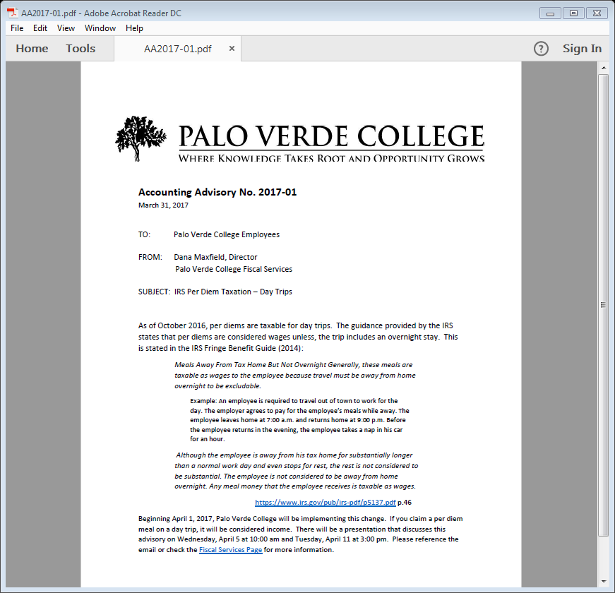
Advisory # and date published
Who it impacts
Who produced doc
Subject
Brief summary of change
Documentation
Follow up or guidance

Slide 3
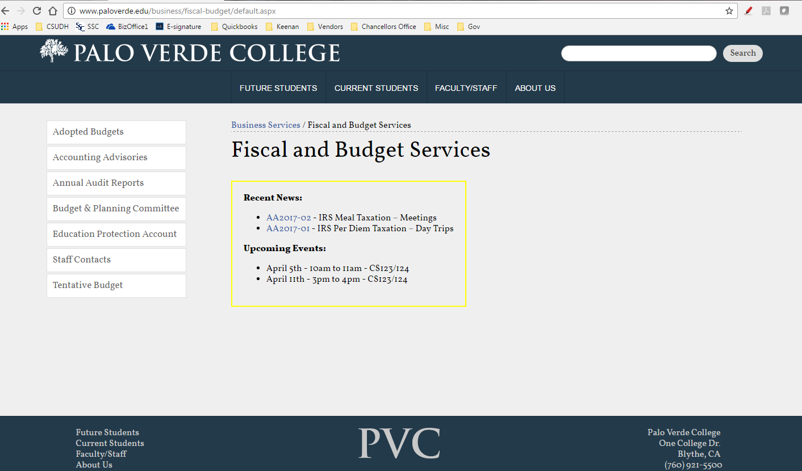
Accounting Advisory database
Most recent Advisories and any upcoming meetings

Slide 4
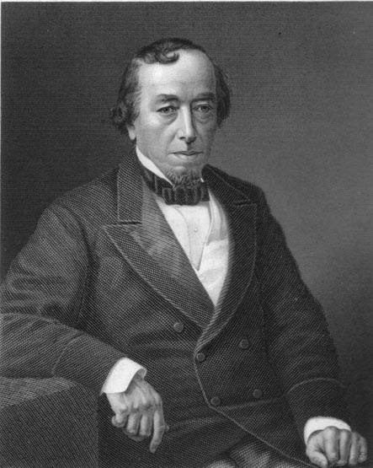
Why are we doing this?
To keep you informed of changes
So you understand why things are changing
So you know what to do going forward
Change is inevitable. Change is constant
Benjamin Disraili – British Prime Minister 1868 - 1880

Slide 5
Accounting Advisory No. 2017-01 Per Diem Tax – Day Trips

Slide 6
Meals Away From Tax Home But Not Overnight Generally, these meals are taxable as wages to the employee because travel must be away from home overnight to be excludable. Example: An employee is required to travel out of town to work for the day. The employer agrees to pay for the employee’s meals while away. The employee leaves home at 7:00 a.m. and returns home at 9:00 p.m. Before the employee returns in the evening, the employee takes a nap in his car for an hour. Although the employee is away from his tax home for substantially longer than a normal work day and even stops for rest, the rest is not considered to be substantial. The employee is not considered to be away from home overnight. Any meal money that the employee receives is taxable as wages. https://www.irs.gov/pub/irs-pdf/p5137.pdf p.46

Slide 8
Accounting Advisory No. 2017-02 Meal Tax - Meetings

Slide 9
Reimbursements or allowances provided to employees for meals in the course of entertaining customers may be excludable if the expenses are ordinary and necessary, and meet either a Directly-Related Test or an Associated Entertainment Test. Directly-Related Test – Entertainment-related meal reimbursements may be excludable from wages if: • The main purpose of the combined business and meal is the active conduct of business; • Business is actually conducted during the meal period; and • There is more than a general expectation of deriving income or some other specific business benefit at some future time. All of the facts must be considered, including the nature of the business transacted and the reasons for conducting business during the meal. If the meal takes place in a clear business setting and is for your business or work, the expenses are considered directly related to your business or work. Reg. §1.274-2(c) and (d) Examples of Directly-Related Meals or Entertainment • Meals at a hospitality room sponsored by an employer at a convention. • Entertainment of civic leaders at the opening of a new city hall. Associated Entertainment Test - Entertainment-related meal reimbursements meet the associated test and are excludable if the entertainment is: • Associated with the active conduct of the employer’s business; and • Directly before or after a substantial business discussion. Generally, an expense is associated with the active conduct of a business if there is a clear business reason for incurring it. The purpose may be to get new business or to encourage the continuation of an existing relationship. These activities are not required to occur in a clear business setting. Whether a business discussion is substantial depends on the facts of each case. A business discussion will not be considered substantial unless you can show that you actively engaged in the discussion, meeting, negotiation or other business transaction to get income or some other specific business benefit. You must be able to show that the business discussion was substantial in relation to the meal. Reg. §1.274-2(c) and (d) https://www.irs.gov/pub/irs-pdf/p5137.pdf pp. 46 - 47

Slide 11
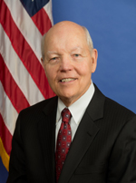
John Koskinen
Commissioner of IRS
Assumed Office: 12/23/13
Previously: Chairman of Freddie Mac
Internal Revenue Service
1111 Constitution Avenue, NW
Washington, DC 20224
Retrieved from www.irs.gov

