Slide 1
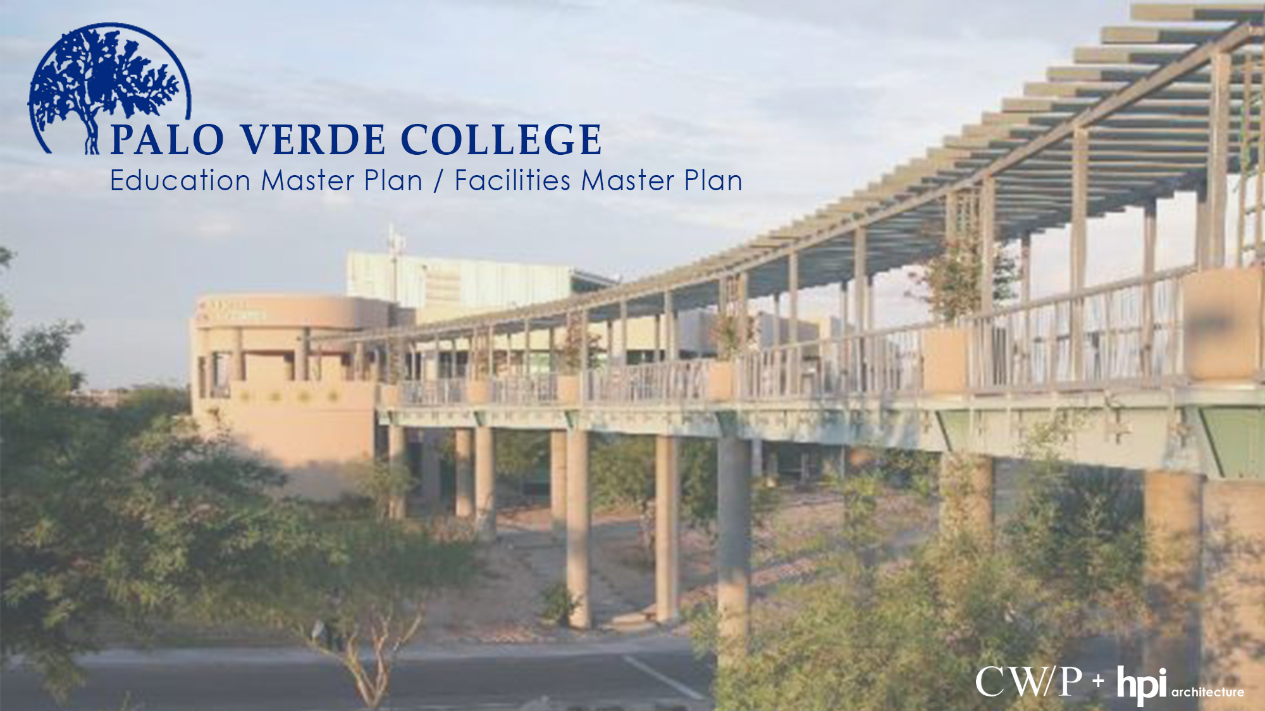
October 2015

Slide 2
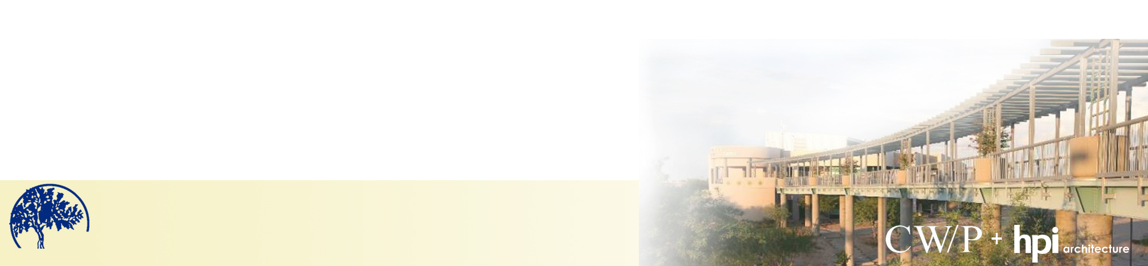
T H E T E A M
Palo Verde College
Blythe, California
Cambridge West Partnership
Irvine, California
HPI Architecture
Newport Beach, California
Palo Verde Community College
C.M. Brahmbhatt
Senior Partner & Manager
Joyce Black
Senior Partner & Project Leader
Dr. Fred Trapp
Educational Master Plan Leader
Lawrence Frapwell
President & Principal-in-Charge
Megan Gaunce
Facilities Planning Project Leader
Palo Verde Community College
Education Master Plan / Facilities Master Plan

Slide 3
OUR EXPERIENCE
Cambridge West Partnership
Irvine, California
HPI Architecture
Newport Beach, CA
Participated in the development of over 20 Educational/Facilities Master Plans & 5 Educational Centers
Experienced in Bond Development & Planning
Support for Accreditation & Educational Master Planning
Preparation of 5YCP, Report 17, IPP’s & FPP’s
Excellent Reputation at the Chancellor’s Office
Have qualified over $600 million for State Funding
Over three decades of Programming, Planning & Design for Public & Private Colleges & Universities
Experienced in Postsecondary Facilities Planning
Recent involvement with 11 CA Community College Districts @ 18 Colleges
Recent CA Community College Facilities Master Planning @ 9 Colleges
More than 800,000 s.f. of CA Community College construction projects in the last 6 years
Palo Verde Community College
Education Master Plan / Facilities Master Plan

Slide 4
CLIENTS WE SERVE
CA Community College Districts
CA Community Colleges
CWP HPI
CWP HPI
Coast Community College District
Kern Community College District
Long Beach Community College District
Mt. San Antonio College District
Cerritos Community College District
Riverside Community College District
El Camino College District
Los Angeles Community College District
Southwestern Community College District
Rancho Santiago Community College District
Barstow Community College
Palo Verde Community College District
Palomar Community College District
San Jose Evergreen Community College District
Orange Coast College
Golden West College
Coastline College
Bakersfield College
Porterville College
Cerro Coso College
Long Beach City College – PCC
Long Beach City College - LAC
Mt. SAC
Cerritos College
Southwestern College
Norco College
El Camino College
Pierce College
Santa Ana College
Santiago Canyon College
Palomar College
San Jose City College
Evergreen Valley College
Palo Verde Community College
Education Master Plan / Facilities Master Plan

Slide 5
GOALS
Campus involvement in the process
Provide the optimal physical setting to support the academic mission of the college
Provide a blueprint for campus development and a resource for decision-making
Palo Verde Community College
Education Master Plan / Facilities Master Plan

Slide 6
GUIDEING PRICIPLES
All campus planning begins with the program of instruction.
Planning must be built with & be supported by the college community.
All plans must be integrated into a unified whole
supporting the college’s strategic plan.
Hands on approach & the ability to implement the clients
thoughts & ideas into working plans & finished products.
Palo Verde Community College
Education Master Plan / Facilities Master Plan

Slide 7
GOALS & OBJECTIVES
Supporting student access, learning & teaching.
Balancing & supporting socialization & formal learning.
Creating unique “places”.
Fostering environmental responsibility.
Maintaining student safety.
Palo Verde Community College
Education Master Plan / Facilities Master Plan

Slide 8
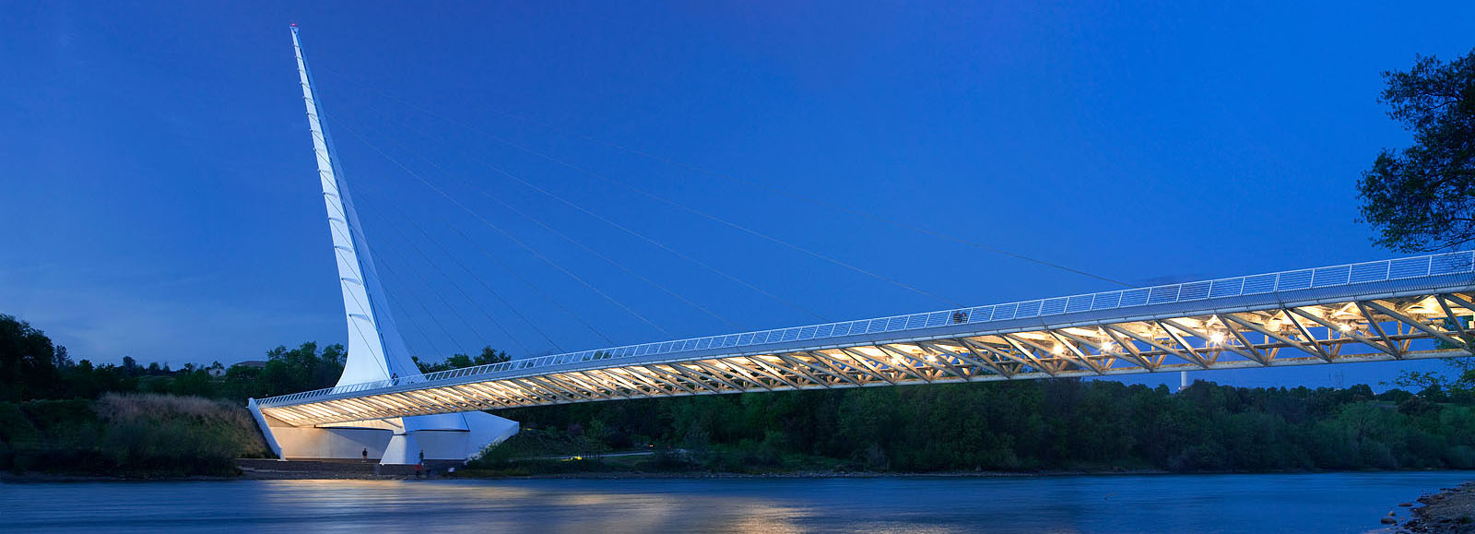
EMP & FMP APPROACH
Projections for the Future
  Future Capacity for Growth
  WSCH Growth as Applied to the Future Program of Instruction
Bridging the EMP & FMP
Palo Verde Community College
Education Master Plan / Facilities Master Plan

Slide 9
EDUCATIONAL MASTER PLAN
Palo Verde Community College
Education Master Plan / Facilities Master Plan

Slide 10
TITLE 5 CHANGE (2007)
T5 51008 Comprehensive Plan
(a) The governing board of a community college district shall establish policies for, and approve comprehensive or master plans, which include academic master plans and long range master plans for facilities. The content of such plans shall be locally determined …
Palo Verde Community College
Education Master Plan / Facilities Master Plan

Slide 11
ACCREDITATION
Recent accreditation activities now “look for” an EMP as part of integrated planning
Palo Verde Community College
Education Master Plan / Facilities Master Plan

Slide 12
PURPOSE OF THE EMP
Address Educational & Support Services Needs
  Facilities implications from enrollment growth projections
  Mix of educational programs & match to service area
Palo Verde Community College
Education Master Plan / Facilities Master Plan

Slide 13
PURPOSE OF THE EMP
Review the learning environment for:
  Changes in teaching methodology & delivery of instruction
  Potential new programs of instruction
  Impacts of technology
Serves as a long-term planning document
  Perhaps revisited every six to seven years with the accreditation cycle
Palo Verde Community College
Education Master Plan / Facilities Master Plan

Slide 14


EMP IS NOT…
The same as a functional-level plan
  Technology
  Distance Education
  Student Success and Support Program
  Student Equity
Palo Verde Community College
Education Master Plan / Facilities Master Plan

Slide 15
EMP OVERVIEW
Message from President
Introduction
College History & Overview
Mission, Vision, Values
Environmental Scan
  External
  Internal
Plan Assumptions and Strategic Priorities
Opportunities for the Future
Projections for the Future Growth
Palo Verde Community College
Education Master Plan / Facilities Master Plan

Slide 16
PROCESS
Selection & Kick Off- Fall 2015
Fall 2015
  Data collection & analysis, preliminary findings presentation
Spring 2016
  Interviews
  Presentations to Planning & Budget Committee & Campus
  Open house sessions
  Academic Senate presentation
  Board presentation
Palo Verde Community College
Education Master Plan / Facilities Master Plan

Slide 17
DATA COLLECTION
External data, documents, research
Recent College plans, research, projects, program reviews
Questionnaire and structured interviews (faculty & academic deans)
Email exchanges (faculty & academic deans)
Exchange of information with HPI (FMP)
Palo Verde Community College
Education Master Plan / Facilities Master Plan

Slide 18
CORE QUESTIONS
1. How much additional instructional space will Palo Verde College need into the future?
2. What might be the curriculum options to match labor market needs and transfer opportunities?
But, wait there is more…..
Accreditation considerations
Palo Verde Community College
Education Master Plan / Facilities Master Plan

Slide 19

QUESTIONS
Palo Verde Community College
Education Master Plan / Facilities Master Plan

Slide 20
INTEGRATING EMP & FMP
CWP & HPI are “married”
Translation of space need corrections and projections future need from growth
Articulation of new instructional or student support programs
Understanding the campus vision
Palo Verde Community College
Education Master Plan / Facilities Master Plan

Slide 21
FACILITIES MASTER PLAN
Palo Verde Community College
Education Master Plan / Facilities Master Plan

Slide 22
FMP APPROACH
Creating a framework of systems to support current & future growth & campus improvement : a roadmap bringing all projects together to serve one vision.
Palo Verde Community College
Education Master Plan / Facilities Master Plan

Slide 23
STRENGTHS, OPPORTUNITIES, WEAKNESS, THREATS
campus systems & considerations
Highest & Best Use of Existing & Planned Facilities
Campus Zoning
Vehicular Access & Circulation
Parking
Public Transportation
Utilities & Infrastructure
Pedestrian Circulation
Open Space Character
Sustainability
Project Sequencing
Palo Verde Community College
Education Master Plan / Facilities Master Plan

Slide 24
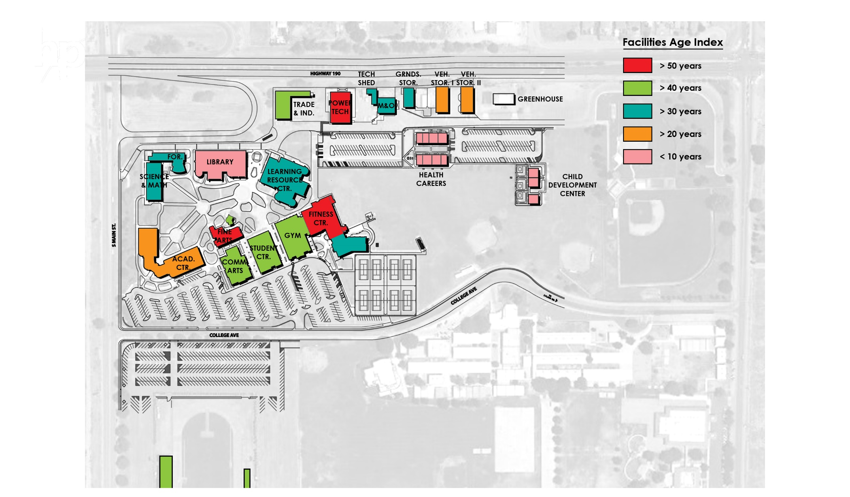
building age
Age of buildings
Age of infrastructure
Campus zoning
Space efficiency
Operational efficiency
Palo Verde Community College
Education Master Plan / Facilities Master Plan

Slide 25
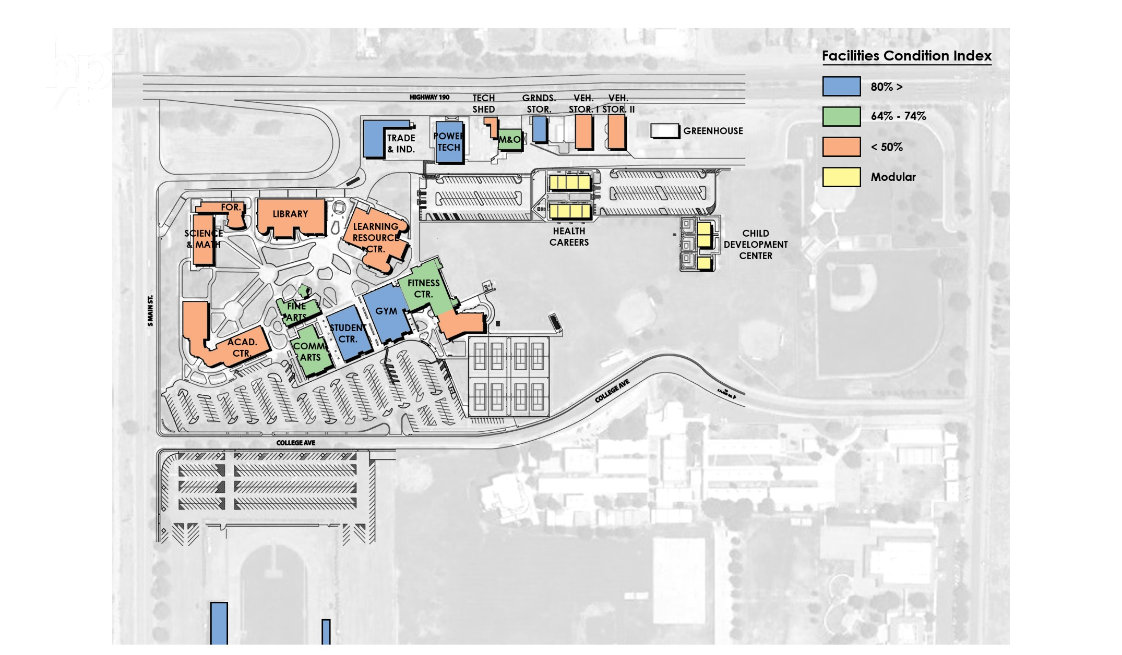
facilities condition analysis
Condition of buildings
Condition of infrastructure
Campus zoning
Space efficiency
Operational efficiency
Palo Verde Community College
Education Master Plan / Facilities Master Plan

Slide 26
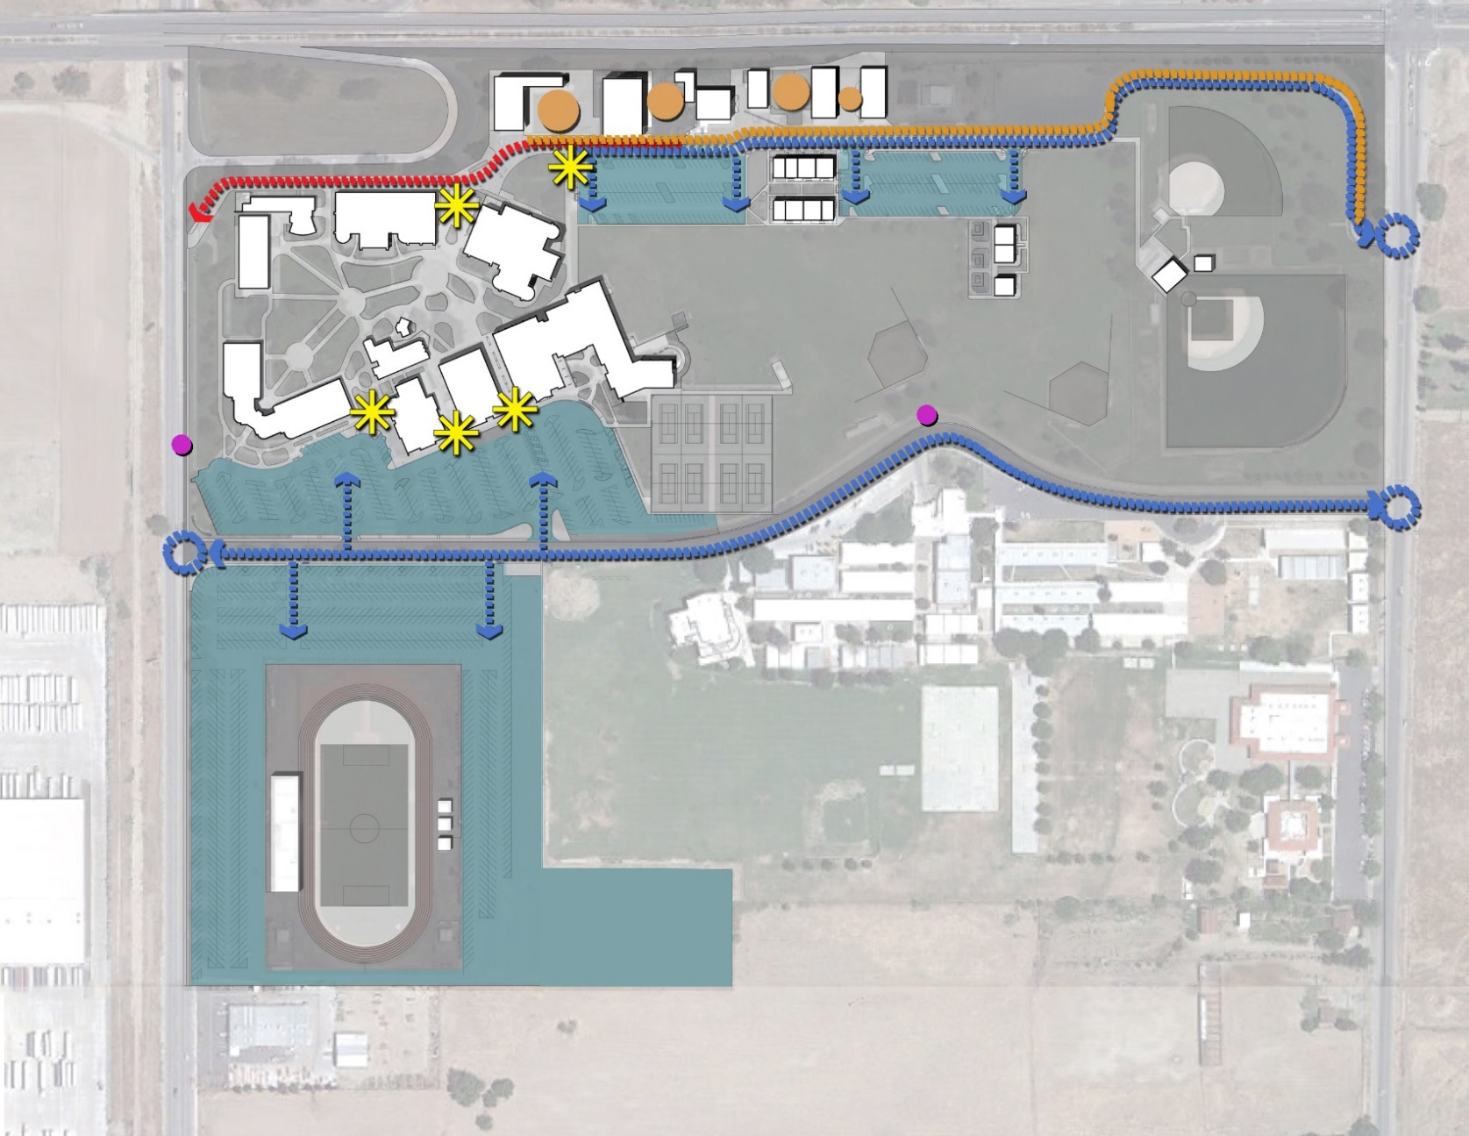
campus access
Bifurcated campus
Unevenly distributed parking
Lack of identity at “Front Door”
N
Palo Verde Community College
Education Master Plan / Facilities Master Plan

Slide 27
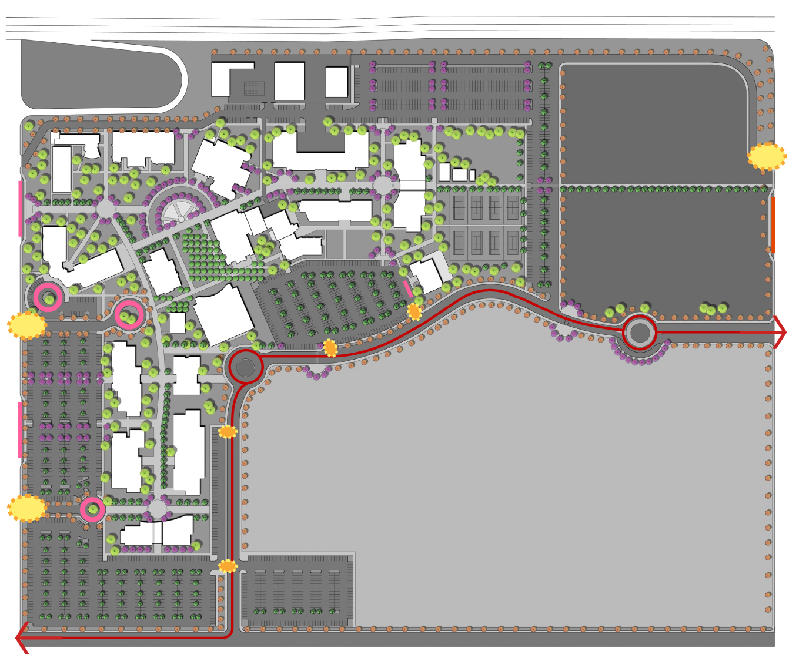
campus access
Re-defined roadway
Re-distributed parking
New front door
Multiple drop – offs
N
Palo Verde Community College
Education Master Plan / Facilities Master Plan

Slide 28
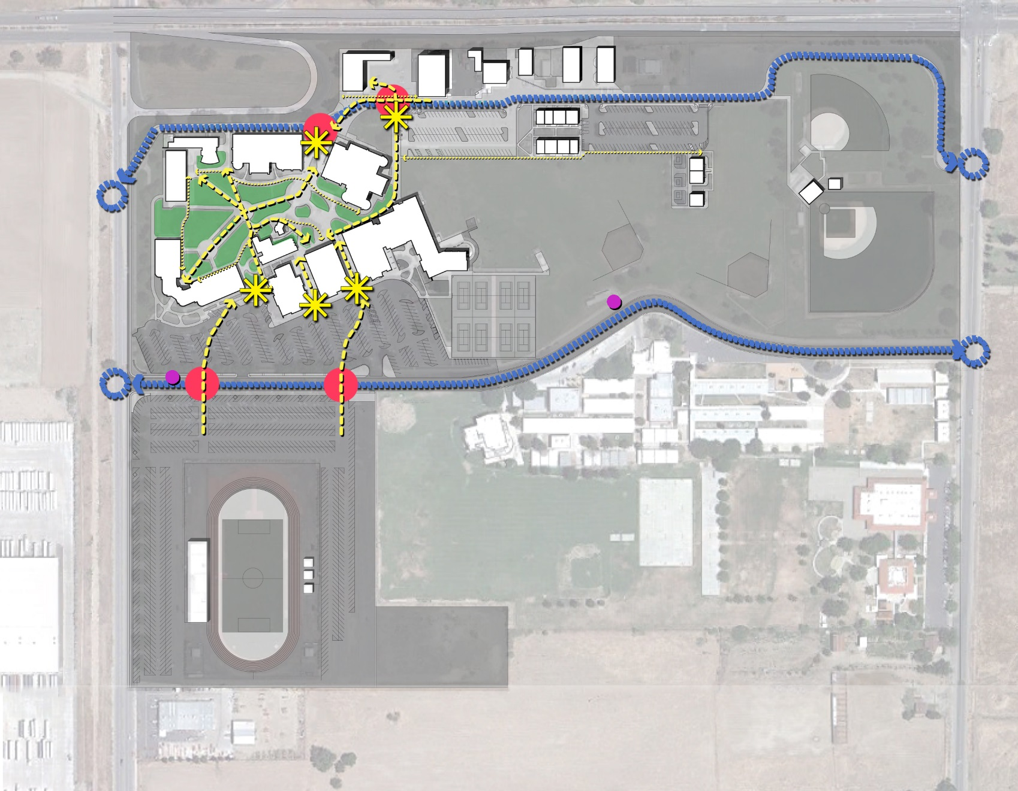
pedestrian circulation
Lack of “Campus Core”
Restricted pedestrian circulation
N
Palo Verde Community College
Education Master Plan / Facilities Master Plan

Slide 29
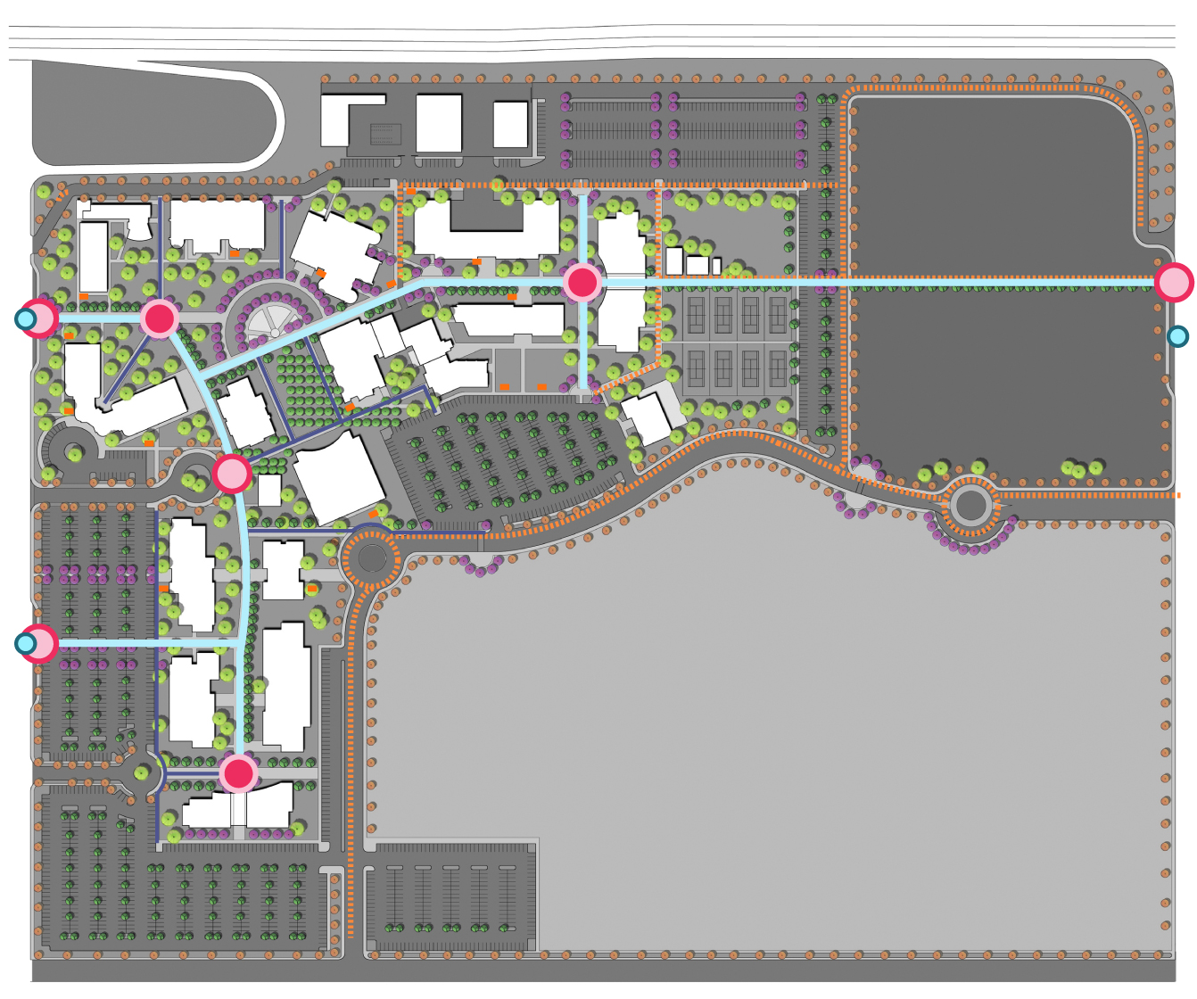
pedestrian circulation
Hierarchy of open space
Defined path of travel
Spaces for student gatherings
Bike path
N
Palo Verde Community College
Education Master Plan / Facilities Master Plan

Slide 30
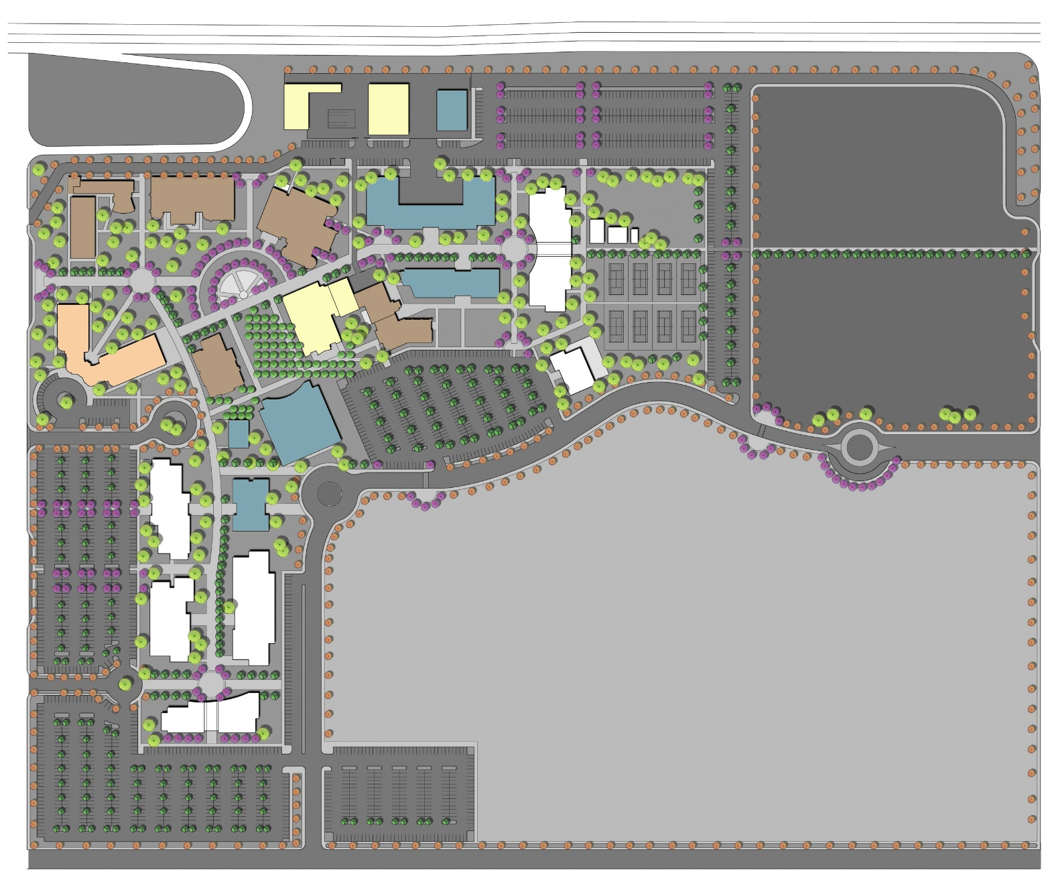
program of work
Renovation / Repurpose / New
Sequence
Cost / TCO
Palo Verde Community College
Education Master Plan / Facilities Master Plan

Slide 31
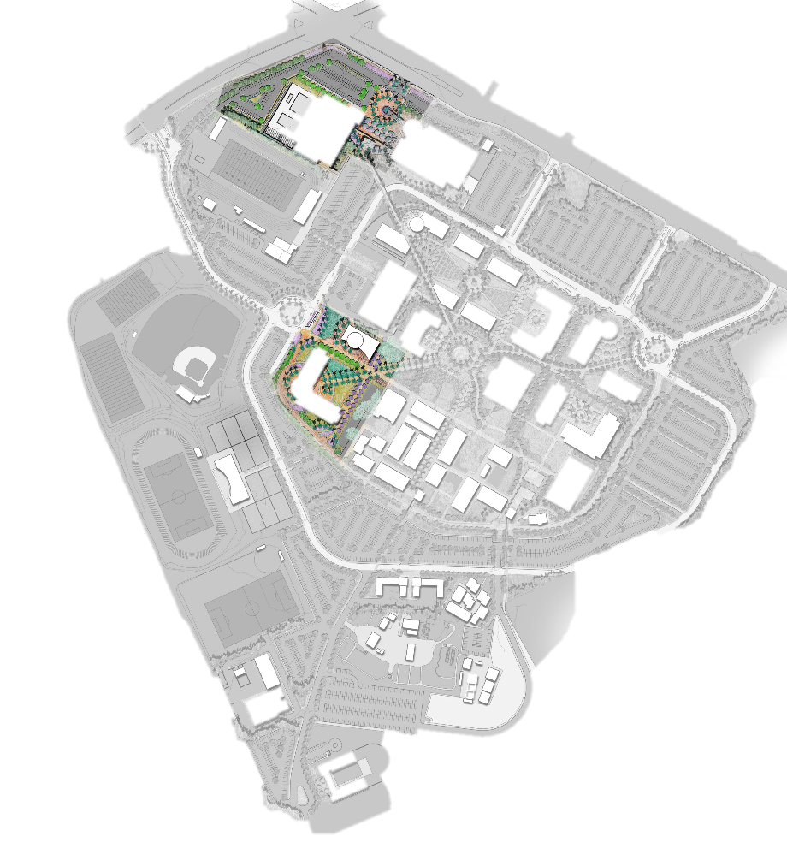
Planning & Zoning
Wellness Complex
Programs:
  Wellness Center
  Gym
  Pool Facilities
ASF / GSF / Mass:
  37,800 ASF / 54,000 GSF / 2 Stories
Timeline:
  2014 – 2016
Vacates:
  Gymnasium, Pools, Racquetball,
  Bldgs: 1000, 1006, 2008
H STREET
OTAY LAKES ROAD
2
1
Math / Science Complex
Buildings:
  Math Science Building
  Planetarium / Exhibit / Large Lecture Building
ASF / GSF / Mass:
  59,720ASF / 91,880 GSF / 2 Stories
  7,300ASF / 11,250 SF / 1 Story
Timeline:
  2016 – 2018
Vacates:
  300’s & Various Classrooms on Campus
N
Palo Verde Community College
Education Master Plan / Facilities Master Plan

Slide 32
Campus Vision
required project sequencing
Construction Complete
 |  |  |  |  |  | Wellness/Gymnasium |  |  |  |  |  | Performing Arts |  |  |  | Student Union Complex
2016
 |  |  |  |  |  |  | Math Science |  |  |  |  | Fine Arts 1 |  |  |  |  | Bookstore Rev
2018 |  |  | Planetarium
 |  |  | Lecture Halls
 |  |  | Administration |  |  |  | Bus/CIS, Comm |  |  |  |  | Gallery/Food Court
2020
 | 1600's |  |  |  |  |  | Student Services |  |  |  |  | Fine Arts 2
2022 | Journalism (660)
 |  |  |  |  |  |  | Academic Success
2024
 |  |  |  |  |  |  | 420 Remodel Language Arts
2025
Palo Verde Community College
Education Master Plan / Facilities Master Plan

Slide 33
TIME LINE
2015 October
Fall
2016 Winter
Spring
June
Education / Facility Master Plan kick-off
EMP: Data Collection
FMP: Data Collection
FMP: SWOT Analysis / Draft 1 Review
EMP: Interviews
Presentations to Steering Committee & Campus
Open house sessions
Academic Senate presentation
Board presentation
FMP: Final Draft Review
EMP & FMP: Presentation to the SJECCD Board of Trustees
Palo Verde Community College
Education Master Plan / Facilities Master Plan

Slide 34
D I S C U S S I O N :
Q U E S T I O N S & A N S W E R S
Palo Verde Community College
Education Master Plan / Facilities Master Plan

